Slide 1
Comparison of Ibo and American weddings
Mrs. Hanson

Slide 2
Is there an engagement period before the wedding?
Ibo Culture
American Culture
Men from the groom’s family visit the girl’s family
The bride helps to serve a meal to the men so they can see her.
The two families negotiate a “bride price.”
There is an engagement period in America.
A man usually proposes marriage to a woman and he does this by himself.
The decision to marry is between him and the bride.

Slide 3
Is there an engagement period before the wedding?
Ibo Culture
American Culture
The girl has little to say about the arrangement.
If the families agree, the wedding will be planned.
“She gave the dish to her father’s oldest brother and then shook hands, very shyly, with her suitor and his relatives. She was about sixteen and just ripe for marriage. Her suitor and his

Slide 4
Ibo Culture
relatives surveyed her young body with expert eyes…” (Achebe 71).

Slide 5
What happens before the wedding?
Ibo Culture
American Culture
The bride’s family prepares for a celebration.
Men pound the yams into foofoo and split firewood.
Women help the bride’s mother cook the feast of traditional foods (yam foofoo, vegetable soup, and goat).
The bride’s family can prepare food for the reception or
A cater can bring food for the reception.
A photographer comes to take pictures of the bridal party and family.

Slide 6
What happens at the wedding?
Ibo Culture
American Culture
The bride’s family hosts a large meal for the bride’s village and the groom’s family.
There is no exchange of rings or vows.
Weddings often involve a religious ceremony.
Most weddings involve the exchange of rings and vows.

Slide 7
What happens at the wedding?
Ibo Culture
American Culture
The bride and other women dance for the men.

Slide 8
Where does the wedding take place?
Ibo Culture
American Culture
Takes place at the home of the bride
Can take place in many locations:
Church
Hotel or restaurant
Barn
Destination such as a beach

Slide 9
What happens after the wedding?
Ibo Culture
American Culture
After the meal the bride goes home with the groom;s familyfor a 7 week trial marriage.
There is no trial marriage.
The bride and groom might go on a honeymoon

Slide 10
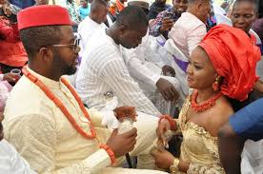
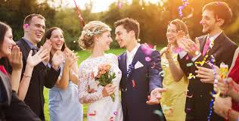
Ibo Culture
American Culture

Slide 11
Photo Credits
American Wedding: https://wheatandtares.org/2017/10/03/wedding-traditions-sexist-nightmares/
Ibo Wedding:
https://encrypted-tbn0.gstatic.com/images?q=tbn:ANd9GcTf8qwUWBdEx9MKYAVry6rxGQZEHN0RzJMH7yUIhifoa-7ax5uq

Slide 12
Works Cited
Achebe, Chinua. Things Fall Apart. Anchor Books, 1959.
“Before Colonialism.” Igbo Weddings, iboweddings.weebly.com/before-colonialism.html
“Marriage Customs - Things Fall Apart P3.” Google Sites, sites.google.com/a/rfschools.com/things-fall-apart-p3/marriage-customs.
Shmoop Editorial Team. “Things Fall Apart Gender Quotes Page 7.” Shmoop, Shmoop University, 11 Nov. 2008, www.shmoop.com/things-fall-apart/gender-quotes-7.html.

